Slide 1
Digital MTC Pass using PWA
Team Members
Divya Prakash J - 113217104030
Praveenkumar RA - 113217104090
Sriram B - 113217104122
Guide
Mrs.T.Subashini
(Assistant Professor - III)

Slide 2
Problem Statement
Now a days, at Tamil Nadu Depot , MTC bus passes are processed manually such as bus pass fares are calculated manually, consumes more time on waiting in queue to renew bus pass. On other side, commuters are carrying bus pass on hand which has more probability of missing it. Also, the entry in bus pass are done manually by the conductors. This process becomes too hectic in a crowded bus.

Slide 3
Abstract
As digital Technology dominates the current situation, the objective of this app is to provide the latest digital way of using MTC Pass which allows commuters to mark their trip by scanning QR codes to monitor their travel. With the help of the Progressive web app, bus commuters can digitally mark their trip by just scanning a QR code. Instead of carrying an MTC card, commuters can install this app and mark their trip digitally by scanning the QR Code. Also, bus commuters can check the dashboard provided by the app to see the number of trips taken on a respective day with the boarding and destination point. This app maintains a database that stores the commuter's trip details and updates the trip count every day. This app also provides an option to renew the current bus pass. Once renewed, this app starts monitoring the trips till the next renewal. For security purposes, commuters must log in to the app with their mobile number/ bus pass id with their Date of Birth. The login credentials are verified with the details provided at the time of applying for a bus pass.

Slide 4
Manual MTC Bus pass Renewal at Tamil Nadu Depot (Renewal Counters) - More waiting time
Manual Fare Calculation at Depot - Manual Work
Manual entry of rides in MTC card - Lots of Paperwork
Existing Work

Slide 5
Online Bus pass Renewing Process - Saves time
Automated Fare Calculation - Reduces manual work
Route Detection and Validation - Prevents Illegal use of Pass
Proposed System

Slide 6
Literature Survey
“Smart Bus pass System Using Android”, 2019 1st International Conference on Innovations in Information and Communication Technology (ICIICT), 25th April 2019
Online Platform for buying and renewing bus pass.
Focusses on Monthly, Student & Senior citizen pass.
Documents will be verified by School/ College Admin or Depot officer.
Bus pass will be sent to the registered email id.
Adds watermark to reduce duplicate passes.

Slide 7
“Smart City Bus Application With QR Code : A Review”, 2019 IEEE International Conference on Automatic Control and Intelligent Systems (I2CACIS), 29th June 2019
Displays Bus routes using Google Maps API
Tracks the live location of the bus
Focusses on QR Payment for buying tickets

Slide 8
“Bus Pass and Ticket automation System”,International Journal of Computer Engineering In Research Trends (IJCERT), 8th August 2016
Provides an android application to avail and renew bus pass through online.
Also user can buy tickets using this app.
QR Code will be pasted on the bus containing bus details
Tickets can be bought by scanning the QR Code.
Notifies the user if bus pass gets expired.

Slide 9


System Architecture Diagram
MTC Pass Registration/ Authentication and
Fare Calculation
Displaying Commuter Profile
Depot Admin
Database
Route Detection & Validation
Commuter
Login
Dashboard
QR Code Scanning
Commuter
Renewing Seasonal Pass
Mockup Payment
View Trip Details

Slide 10
Modules
Commuter End
1) Login
Authenticating the bus commuter
2) Dashboard
Provides an option to scan qr or renew bus pass
3) QR Code Scanning
Scanning the QR code to mark the trip.
4) Route Detection & Validation
Detecting the right route traveled by user
5) Trip Details
Capturing & Storing the trip details for monitoring purpose
6) Renewal Process
e-Renewal of bus pass. Available only for seasonal pass
Admin End (Depot)
1) Registration
User Registration at depot. For college and regular commuters
2) Fare Calculation
Fare calculation is based on types of user , travelling routes

Slide 11
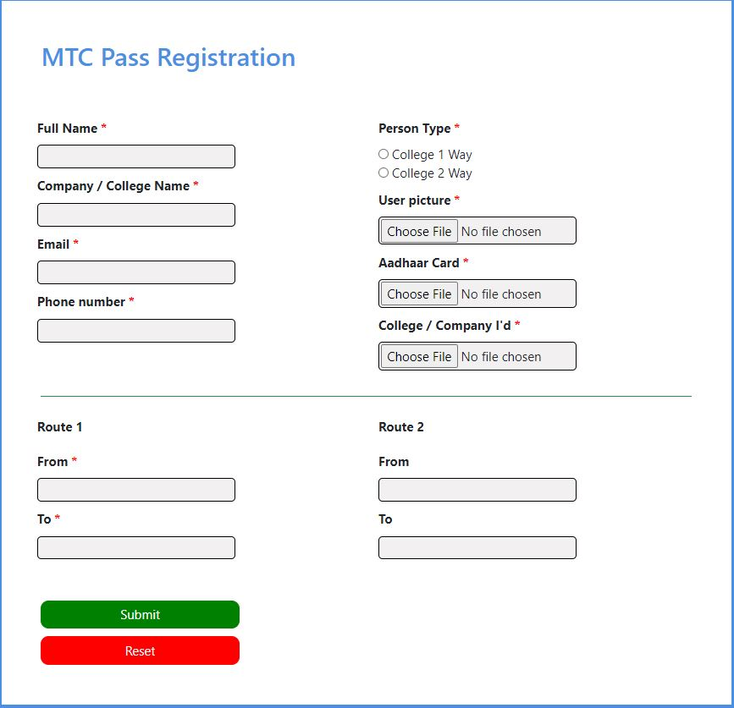
Registration and Fare Calculation
Fare is calculated based on the number of stages between the Boarding and Destination Point
In case of more routes, fare is calculated with the route which has maximum number of stages

Slide 12
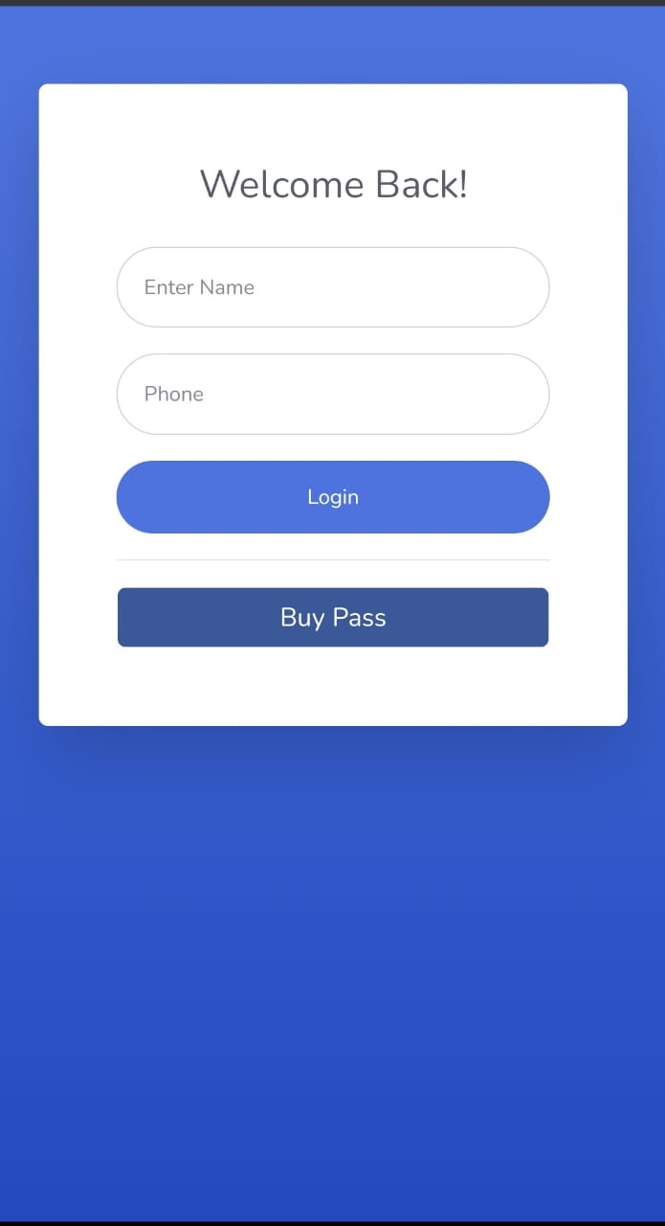
Login Module
Contains login form for authentication purpose.
A Commuter can login into the app using their mobile number and Name.
Also , commuter can buy monthly / daily pass from this page.

Slide 13
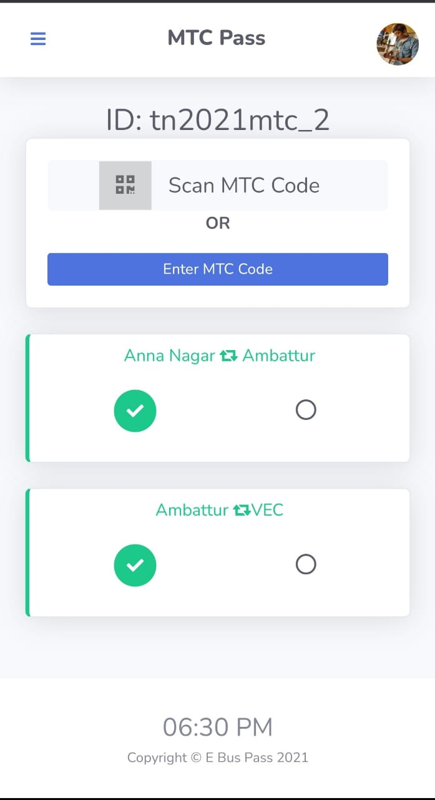
Dashboard
Option to Scan the QR code
Option to renew the bus pass
Displays the count of trips taken
Displays the route details - Boarding point & Destination point

Slide 14
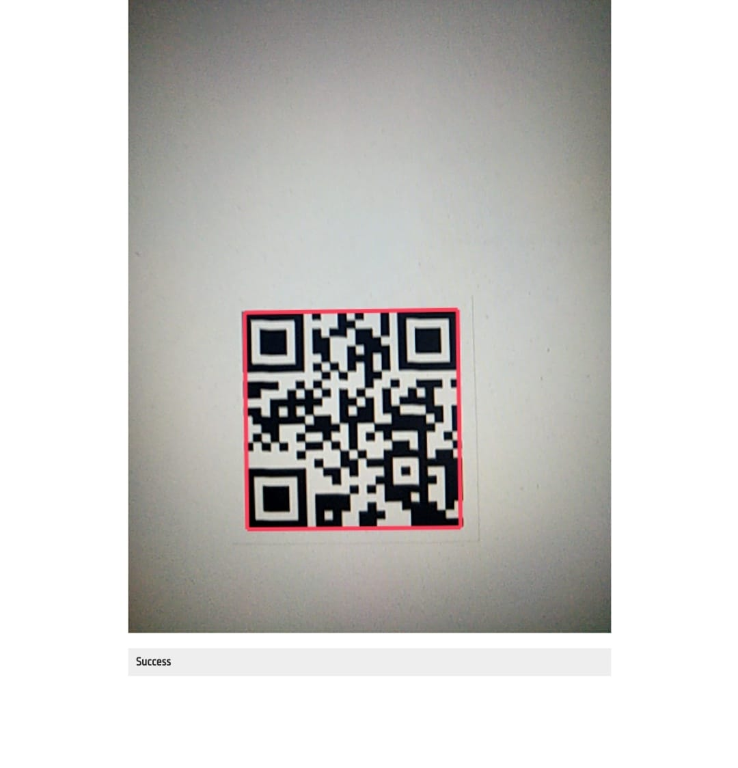
QR Code Scanning
Marking the trip by scanning the QR Code
QR Code contains the MTC bus number
Scanning invalid QR Code will be alerted

Slide 15
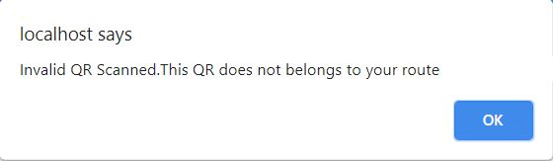
Route Detection and Validation
Validates whether the commuter scans the QR belongs to his bus pass route
Throws alert, if commuter scans the QR of different route
Otherwise, mark the trip in epass

Slide 16
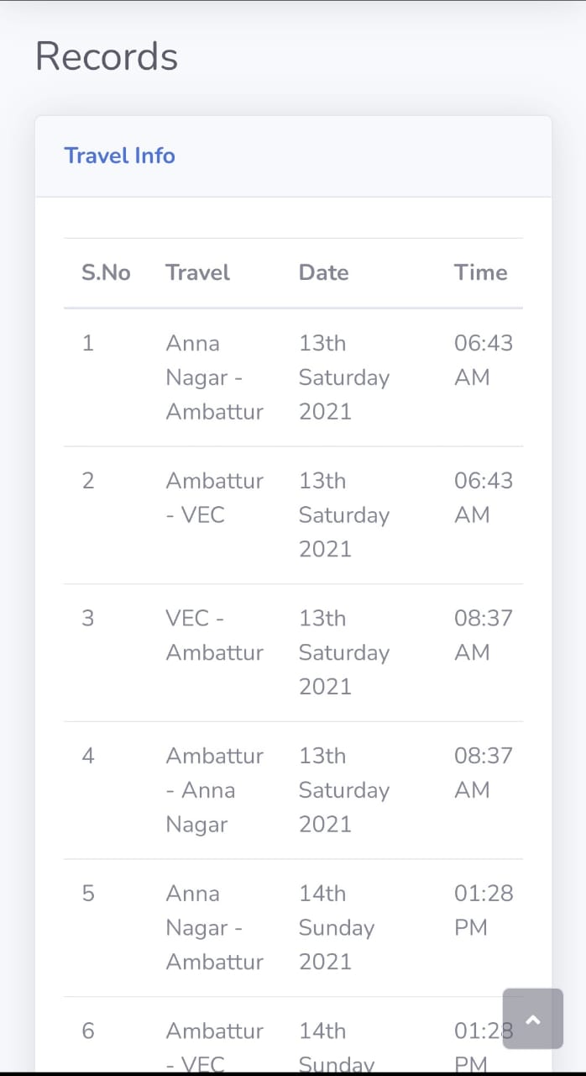
Trip Details
Displays the following trip details
Route
Date of the trip
Time when trip is marked

Slide 17
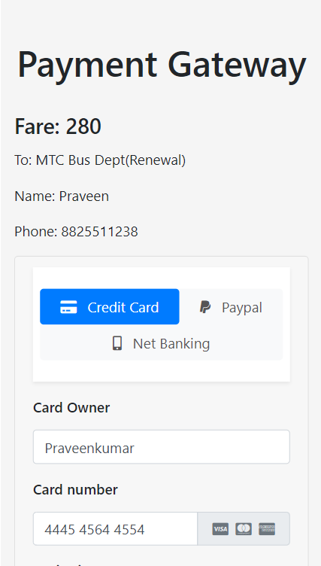
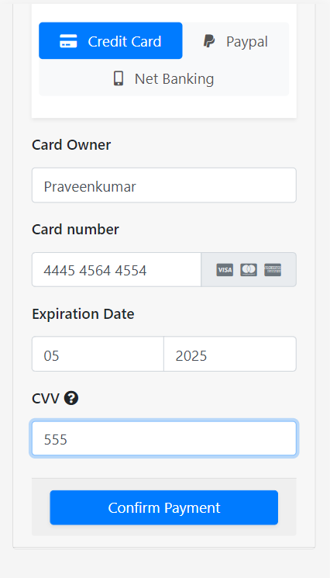
Renewal Process
Online Bus pass Renewal process
User can renew from the 1st day of the month.
Once the bus pass gets expired, user must renew their bus pass to continue
Once renewed, user can use the bus pass

Slide 18
Conclusion
Makes the application more user - friendly for the bus commuters.
Provides easy platform to buy and renew the MTC pass.
This single app takes care of all types of Bus Passes and their Renewal Process.

Slide 19
Future Work
In future, this application will be replaced with simple PVC card
In future, Bus pass process for Handicap will be included.
In future, the mockup payment will be replaced with paid payment gateway.

Slide 20
References
[1] V, Pandimurugan & R, Jayaprakash & V, Rajashekar & K, Yogeshwar, “Smart Buspass System Using Android” in Conference on Innovations in Information and Communication Technology (ICIICT), Chennai, India, 2019
[2] Sim Liew Fong; David Wui Yung Chin; Rabab Alyaham Abbas; Arshad Jamal; Falah Y. H. Ahmed, “Smart City Bus Application With QR Code : A Review”, 2019 IEEE International Conference on Automatic Control and Intelligent Systems (I2CACIS), 29th June 2019
[3] P.Sharmila ,A.Ponmalar, Skanda Gurunathan R, “Bus Pass and Ticket automation System” , International Journal of Computer Engineering In Research Trends , Volume 3, Issue 8, August-2016.
[4] N. Krishnammal, Ramya C, Shiva Ganesh K, ShrenidhiR, “Efficient Bus Pass Generation and Authentication using QR Code”, International Journal of Innovative Technology and Exploring Engineering (IJITEE) ISSN: 2278-3075, Volume-9 Issue-7, May 2020

Slide 21
[5] Miss. Mohini S. Shirsath ,Pooja M. Chinchole,Vaishnavi R. Mahajan, Varsha G. Mogal , “A Review on Smart Bus Ticketing System using QR-Code” , International Research Journal of Engineering and Technology (IRJET) Volume: 05 Issue: 03 | Mar-2018
[6] Nwakanma Ifeanyi Cosmas, Etus C, Ajere I.U. & Agomuo Uchechukwu Godswill , “Online Bus Ticket Reservation System” , International Journal Of Computer Science And Statistics Vol. 1 No.2, 2015
[7] Prof. B. A. Khivsara, Mr. Kakshil J. Jain, Mr. Nilesh M. Shinde, Miss. Kavita B.Pachorkar, Miss. Prachi A. Gandhi, “Smart Bus Ticketing System”, International Research Journal of Engineering and Technology (IRJET) Volume: 07 Issue: 01 | Jan-2020

Slide 22
Thank You !!

